Slide 1
NE 795-014: Advanced Reactor Materials
Fall 2023
Dr. Benjamin Beeler

Slide 2
Last Time
Intro to course
Background and history of HTGRs/TRISO particles
Difference from LWRs
helium cooled; much higher temperatures; thermal/fast options; extensive utilization of graphite; flexibility of fuel
Pebble bed vs Prismatic Reactors

Slide 3
TRISO Particles
TRISO: TRistructural ISOtropic particle fuel
Layered fuel in mm-sized particles
Layers:
Fuel Kernel
Buffer
Inner Pyrolitic Carbon (IPyC)
SiC
Outer Pyrolitic Carbon (OPyC)

Slide 4
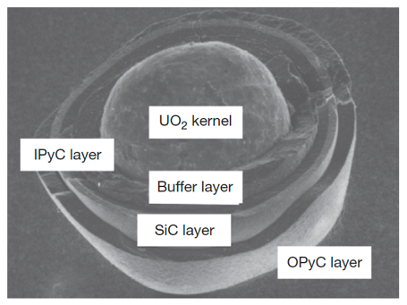
Fuel Kernel + Buffer
A variety of fissile and fertile kernels have been used in particles, including ThC2, ThO2, PuO2, (Th,U)O2, UC2, UO2, and UCO
Nominal fuel kernel diameters range between 100 and 500 microns
The fuel kernel is surrounded by a porous graphite buffer layer that absorbs fission recoils and allows space for swelling and fission gases produced during irradiation
The buffer layer is generally about 100-micron thick

Slide 5
IPyC-SiC-OPyC
Surrounding this inner buffer layer is a layer of dense pyrolytic carbon (IPyC), a silicon carbide (SiC) layer, and a dense outer pyrolytic carbon (OPyC) layer
The pyrolytic carbon layers protect the SiC layer, which is the pressure boundary
The pyrolytic carbon layers are approximately 40-micron thick; the SiC layer is usually about 35-micron thick
Each microsphere acts as a mini pressure vessel, which is designed to impart robustness to the gas reactor fuel system
TRISO diameter is typically ~750 microns

Slide 6
Early Concepts
The concept of nuclear fuel microspheres with refractory coatings to contain fission products during operation in HTGRs can be traced to the Dragon Project in the 1950s
The earliest versions involved fuel kernels coated with only a single pyrolytic carbon layer intended to protect the kernel during fabrication, this rapidly evolved in the following decade into more complex and more effective particle designs
It was recognized almost from the beginning that the coating layers could provide some degree of advantageous fission product retention when properly designed
(a) BISO particle, (b) Particles with “laminated” pyrocarbon layer structure, (c) Particle with “Triplex” structure, (d) Fertile (Th,U)C2 with of PyC-SiC-PyC structure, (e) Carbide particle with single PyC coating, (f) “Duplex” (Th,U)C2 particle

Slide 7
Early Failure
Fracturing of the pyrocarbon layer in these particles during irradiation was found to be a concern
Causes included kernel swelling, radiation-induced pyrocarbon dimensional change, damage from fission recoils, fission gas pressure, and chemical reaction of fission products with the coating
A design modification was the introduction of a sacrificial layer of pyrocarbon between the kernel and the dense, outer pyrocarbon layer
This two-layered particle design was termed “BISO” for Buffer-isotropic

Slide 8
Transition to TRISO
The notion that refractory ceramics could provide significantly improved particle strength and retention of fission products compared to pyrocarbon alone was suggested near the very beginning of coated particle development
This led to the addition of a silicon carbide layer placed between two layers of dense pyrocarbon
This SiC layer, along with the porous buffer layer of BISO particles, formed the basis for the modern TRISO coating design

Slide 9
fuel kernel

Slide 10
Fuel Kernel
Coated particle fuel allows flexibility in kernel material
The porous buffer layer mechanically decouples the kernel from the outer coating, accommodating some degree of kernel swelling
Choice of kernel material is influenced by fabrication concerns, kernel behavior under irradiation, and reactor design
Early designs primarily included fertile carbide fuels (ThC)
Carbide kernels have excellent high-temperature compatibility with the surrounding graphite fuel elements
However, oxide kernels simplify the overall fabrication process (don’t have to worry about oxidation) and maintain better chemical stability during the high temperature heat treatment of fuel pebbles during manufacture

Slide 11
Fuel Chemistry
An important consequence of UO2 fission is the creation of free oxygen since only a part of the O2 recombines with the fission products
In the TRISO particle, a portion of this free oxygen combines with carbon from the buffer/PyC coatings to form CO and CO2 gases
Identification of those compounds (solid and gaseous) that can form in fuel during normal and off-normal conditions and which elements remain in elemental form, is known as fuel chemistry
Changes in fuel chemistry may lead to many important mechanisms affecting fuel performance, e.g., kernel size (swelling), kernel migration (amoeba effect), stresses in the coatings (particle pressurization due to fission products and carbon oxide gases), thermal conductivity, creep properties modification, etc.
The oxygen potential, the pressure of oxygen in the gas phase within the fuel, is the critical parameter determining which elements in their competition for oxygen form oxides

Slide 12
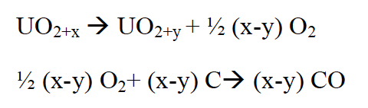
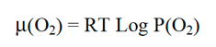
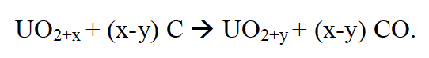
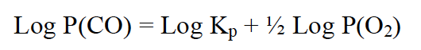
Oxygen Potential
Calculation of the oxygen potential is complex since it generally varies with distance from the particle center and with temperature, fuel burnup, fission product yields, chemical state of fission products including solid and gas phases, and the effectiveness of the coating layers to absorb fission products and oxygen
The oxygen potential is represented by:
where P(O2) is the oxygen partial pressure, R is the gas constant, T is the temperature
In fresh fuel (simpler case), where we assume the fuel reaches thermodynamic equilibrium with its surrounding coatings, the main product of the reaction between UO2+x (x>0) and carbon is gaseous carbon monoxide, CO, by the following reactions:
which can be rearranged as:
Utilizing an equilibrium rate constant K,

Slide 13
Oxygen Potential
Reactions to generate CO2 are also possible, but at applicable temperatures and values of the oxygen potential, CO production dominates
As the oxygen potential, i.e., oxygen partial pressure, is increased we are generating more CO
The result of CO formation is internal pressurization of the particle which may lead, in extreme conditions, to particle failure
To limit this pressurization other fuel kernel concepts have been and are being studied, of particular interest is the oxycarbide fuel (or UCO) comprising a mixture of UC2 and UO2
Gas formation is effectively reduced within the UCO particle as compared to a UO2 particle due primarily to their lower oxygen inventory
Additionally, there is a gettering effect of the UC2 on the oxygen released during UO2 fission which forms a condensed oxide rather than CO gas

Slide 14
CO Pressurization
The result of CO formation is internal pressurizing of the particle that increases with burnup and adds to the pressurization from fission gases
At lower burnup (≤ 6 % FIMA), pressurization of the particle arises principally from fission-gas release from the fuel kernel
At higher burnup (9% FIMA, at 1450 K), the pressure resulting from fission gases can represent half of the contribution of CO in an HTGR TRISO coated particle
The suppression of excessive CO formation during oxidation of a UO2 based particle remains an important design objective at moderate and high burnup
The failure of the SiC layer may happen because of over-pressurization due to CO formation
CO pressures are suspected of being partly responsible for the mechanical weakening of the IPyC coating, and corrosion of the SiC layer by CO can occur as a result from failure of the IPyC coating

Slide 15
Uranium Oxycarbide (UCO)
Work in the US retained the carbide kernel design, because the HTGR designs of required high peak fuel temperatures and high power densities that would result in excessive kernel migration
UC fuel, no worries about CO production
However, it was found that rare earth fission product elements migrating from carbide kernels during irradiation could chemically attack the SiC layer of TRISO particles and compromise the structural integrity

Slide 16
UCO
We have two fuel kernel problems:
CO production (UO2)
fission product release (UC)
This led to the suggestion of a kernel comprised of a mixture of both oxide and carbide phases
Thus, a design was made to include sufficient UC2 to getter the excess oxygen produced by UO2 fission
UCO avoids the formation of CO, while still taking advantage of the retention of the metal oxide fission products in the predominantly UO2 kernel
The success of UCO kernels by the US program led to the adoption of UCO fuel as the reference fissile particle design by the early 1980s, with an approximate UO2/UC2 mixture of 80/20

Slide 17
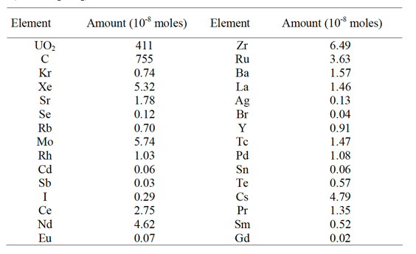
Fission Products
The rate of change of each nuclide is a function of three processes:
depletion of heavy nuclei by fission and corresponding production of lighter nuclei (fission products)
production by radioactive decay (actinides and fission products) and/or by neutron capture (actinides)
loss by radioactive decay (actinides and fission products) and/or by neutron capture (actinides)
Element inventory for a UO2 kernel @ 5.5% FIMA on the right

Slide 18
Fission Products
Fission products in UO2 are primarily located as substitutional atoms, commonly paired with additional vacancies
A large number of fission products are highly insoluble in UO2, including Xe, I, and Br
Some solubility exists for transition metals such as Zr and alkaline metals such as Sr, and high solubility exists for some rare earth elements, such as Ce
Fission products in the fuel lattice can diffuse out of the UO2 to grain boundaries
The diffusion mechanism depends on the nature of the fission product trap sites and on the fission product intrinsic characteristics
Irradiation effects can greatly enhance or reduce this diffusion by trapping mechanisms on extended defects

Slide 19
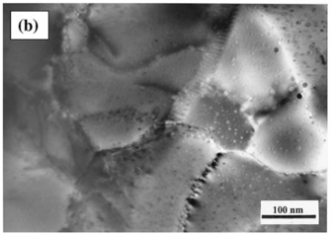
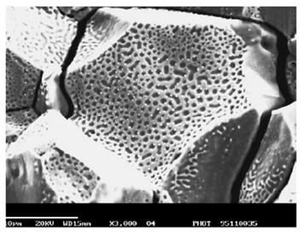
Fission Products
The fission gases precipitate primarily as intragranular bubbles which can grow by gas-atom and vacancy absorption
Fission gases can migrate to grain boundaries by atomic or bubble diffusion to form intergranular bubbles where they can grow by addition of gas and vacancies
Fission-rate helps to strongly limit bubble size and maintain a substantial fission-gas atom population in the fuel lattice by re-solution of gas from bubbles
Once intergranular-bubble growth becomes significant causing interconnection of porosity, a path from within the kernel to the buffer is created leading to fission-gas release by a percolation mechanism

Slide 20
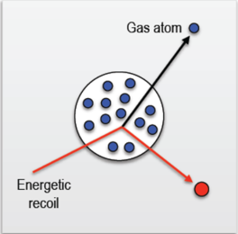
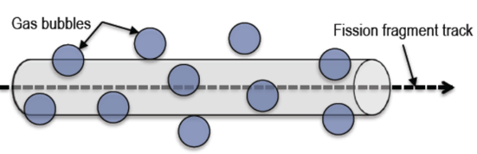
Bubble Resolution
Homogeneous resolution
individual gas atoms are ejected from the gas bubble through collisions with energetic fission fragments or recoil uranium atoms
Heterogeneous resolution
bubble are almost completely destroyed by the passage of a fission fragment

Slide 21
Fission Product Chemistry
Rare earth elements have high solubility in UO2 and form rare earth oxides (REOs)
Zr, Nb and Sr have significant solubility in UO2 and oxidize to form ZrO2, Nb2O3 and SrO
Fission products that either have lower solubility or are less likely to form stable oxides, such as Ba, Te and Mo, diffuse to the grain boundaries and form perovskite or intermetallic precipitates
These grain boundary inclusions can allow for release from the fuel kernel
Ag and Pd are known to form intermetallic precipitates and are readily release from the fuel kernel
Ellingham diagram showing the temperature dependence of the stability of compounds

Slide 22
Fission Product Carbides
In the UCO-type fuel kernel, oxygen liberated during the fission process of UO2, first oxidizes the carbide UC2 phase and then the RE fission products because of their high affinity for oxygen
Those fission product elements with lower affinity for oxygen (Sr, Eu, Zr, Ba) exist as carbide compounds
As the burnup increases, the UC2 phase in the kernel decreases
When UC2 has fully disappeared, the oxygen potential then increases and oxygen is available to form oxide compounds with these fission products
Oxidation diagram for carbides of interest

Slide 23
Fuel Kernel Summary
Flexible composition, allowing for commercial power, fertile, breeder, and burner options
Carbide and Oxide options
Carbides allow for higher power density and higher temperatures, reduce CO production
Oxides retain fission products
US utilizes UCO 80(UO2)/20(UC2) mix
UC2 gets oxidized, then other fission fission products will form oxides
Will cover some other fuel kernel related failure mechanisms later

Slide 24
Silicon Carbide

Slide 25
Silicon Carbide (SiC)
SiC is a very hard and strong non-oxide ceramic that possesses unique thermal and electronic properties
Polycrystalline SiC has a strength of 15 GPa and has excellent creep resistance
SiC’s upper limit of stability is around 2500C and has a melting temperature of around 2830C
SiC also has excellent thermal conductivity
SiC is a highly covalent material that forms tetrahedra that are centered around either carbon or silicon atoms
β-SiC takes the diamond cubic structure with half of the carbons being replaced with silicon; this is a very stable structure that is conducive to phononic heat conduction

Slide 26
Silicon Carbide (SiC)
Silicon carbide (SiC) has been studied and utilized in nuclear systems for decades, primarily as the micro pressure vessel for high-temperature gas-cooled reactor fuels
The SiC must be strong enough to withstand the pressure buildup from the fission product gas liberated and CO produced
The SiC layer must withstand chemical attack from metallic fission products such as palladium
The SiC must be able to handle the mechanical loads derived from irradiation-induced dimensional changes occurring in the pyrolytic graphite
The SiC must maintain its properties during irradiation

Slide 27
Radiation Effects in SiC
The neutron-induced swelling of SiC has been well studied for low and intermediate temperatures (up to 1000 C)
It is well understood that the presence of significant second phases and/or poorly crystallized phases in these materials leads to unstable behavior under neutron irradiation
While high purity, stoichiometric, near-theoretical density SiC can show excellent radiation resistance
Here I will be talking about the good SiC, assuming that the fabrication process has produced appropriately clean coatings

Slide 28
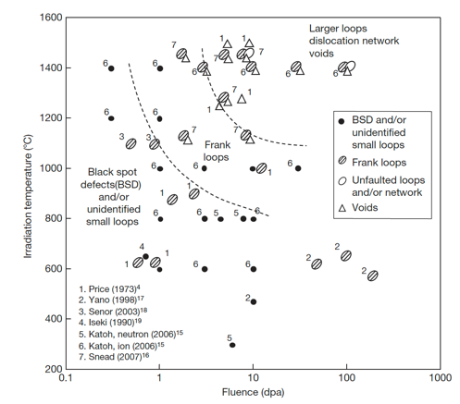
Radiation Effects in SiC
The microstructural evolution map is shown on the right
The contribution of the defects themselves to the swelling in SiC is not well understood

Slide 29
Low T Radiation Effects in SiC
Below 400 K, neutron irradiated SiC microstructure is described as black spot defects, which are most likely clusters of self-interstitial atoms
For irradiation temperatures less than about 423 K, accumulation of strain due to the irradiation-produced defects can exceed a critical level above which the crystal becomes amorphous
The swelling under self-ion irradiation increases logarithmically with dose until amorphization occurs
The swelling of neutron- and ion-amorphized SiC has been reported to be as high as 10.8% at 343K

Slide 30
Low-Med T Radiation Effects in SiC
Above the critical amorphization temperature (423 K), the swelling increases logarithmically with dose until it reaches saturation
The saturation level decreases with increasing irradiation temperature
The dose exponents of swelling during the log period are often close to 2/3, in line with assumptions based on interstitial clusters
This temperature regime is referred to as the point-defect swelling regime and goes from critical amorphization temperature to about 1273 K
Tirr=300 C, 6 dpa
Dot number density 2.2e+24m-3
Mean dot diameter=1nm
Tirr= 800 C, 7.7 dpa
Loop number density 3.3e+23m-3
Mean loop diameter = 3.0 nm

Slide 31
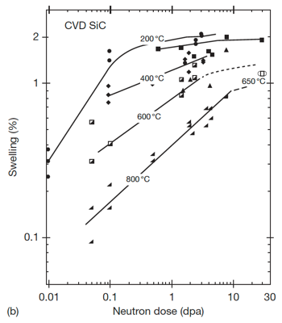
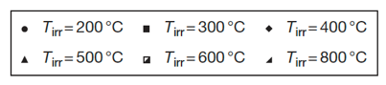
Saturation Swelling in SiC
Log swelling vs dose shown at right for CVD SiC irradiated in HFIR
The swelling of SiC is highly temperature dependent
at 1 dpa, saturation values from 200 C to 800 C vary by a factor of 5
The decrease in saturation with increasing T is due to increased recombination of defects
Swelling saturates at relatively low doses, less than 10 dpa

Slide 32
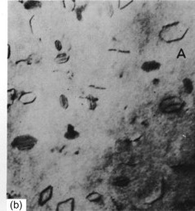
High T Radiation Effects in SiC
Above 1000C, Frank loops of the interstitial type become the dominant defects observed by TEM
Interstitial Frank loops are faulted, in that they include a stacking fault
Consequently, these loops cannot glide and will not move under an applied stress or temperature, and are therefore considered as sessile
At high temperature, the development of Frank loops into dislocation networks through unfaulting reactions at high doses is reported
Frank loops in Al

Slide 33
High T Radiation Effects in SiC
The volume associated with dislocation loops in irradiated SiC has been estimated to be on the order of 0.1%
At high T (greater than about 1500 K) vacancies are sufficiently mobile and vacancy clusters can be formed
This high T regime is the void swelling regime
1130 C, 1.8 dpa
1130 C, 8.5 dpa
1280 C, 5.0 dpa
1450 C, 1.8 dpa
1450 C, 5.0 dpa
1450 C, 8.5 dpa
Evolution of voids in high-temperature irradiated CVD SiC

Slide 34
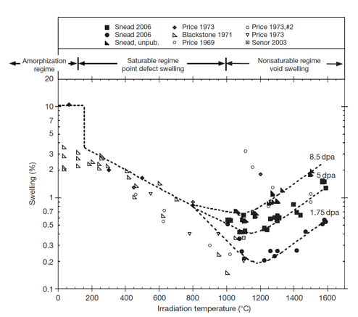
Irradiation-Induced Swelling in SiC
The transition from point-defect saturated swelling to void swelling occurs above 1000C
Void swelling increases as a function of dose, and is not known to saturate
The swelling near the critical amorphization temperature is described as the differential strain between the single interstitial, or tiny interstitial clusters, immobile vacancies, and antisite defects

Slide 35
Irradiation-Induced Swelling in SiC
Above the critical amorphization temperature, the number of defects surviving recombination is reduced and the mobility of both silicon and carbon interstitials becomes significant
Above 1000 C microstructural studies have noted the presence of both Frank loops and tiny voids, indicating limited mobility of vacancies
The max irradiation temperature shown is 0.65 T_{melt}

Slide 36
Irradiation-Induced Swelling in SiC
In typical fcc metal systems void swelling typically begins at ~0.35Tm, goes through a maximum value, and decreases to nil swelling by ~0.55Tm
The voids in SiC are continuing to grow in SiC irradiated to 1773 K, thus the energies for diffusion of either the Si or C vacancy or both must be quite high
This has been confirmed through DFT methods
It is unclear how swelling will increase as a function of dose above 10 dpa

Slide 37
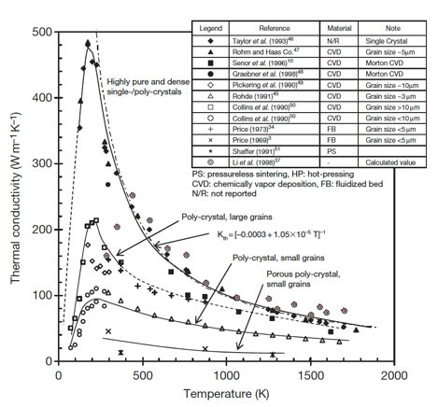
Thermal Conductivity Degradation
SiC is a ceramic with a band gap, and thus thermal conductivity is based on phonons
The conduction heat can be generally described by the strength of the individual contributors to phonon scattering: grain boundary scattering; phonon–phonon interaction; and defect scattering
Each of these types occurs at differing phonon frequencies and can be considered separable

Slide 38
Thermal Conductivity Degradation
The unirradiated k_{th} is highly dependent upon initial microstructure and temperature
Initial microstructure can be tailored, but the temperature dependence cannot be removed

Slide 39
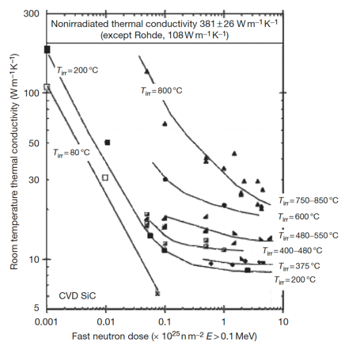
Thermal Conductivity Degradation
At low temperatures irradiation produces simple defects and defect clusters that very effectively scatter phonons
In this case, defect scattering quickly dominates, with saturation thermal conductivity typically achieved by a few dpa
Defect scattering is sufficiently present to eliminate the temperature dependence

Slide 40
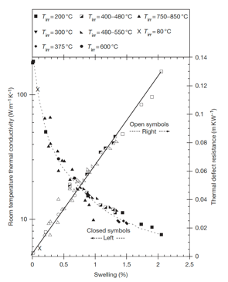
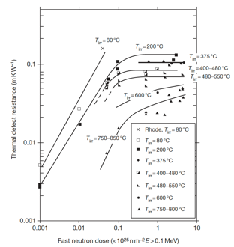
Thermal Conductivity Degradation
The thermal defect resistance is defined as the difference between the reciprocals of the irradiated and nonirradiated thermal conductivity (1/K_{rd} = 1/K_{irr} – 1/K_{nonirr})
This term can be related directly to the defect type and concentration present in irradiated ceramics
The thermal defect resistance is directly proportional to the irradiation-induced swelling in SiC, and is independent of temperature
This allows an indirect determination of thermal conductivity by measurement of the density change in the TRISO SiC shell

Slide 41
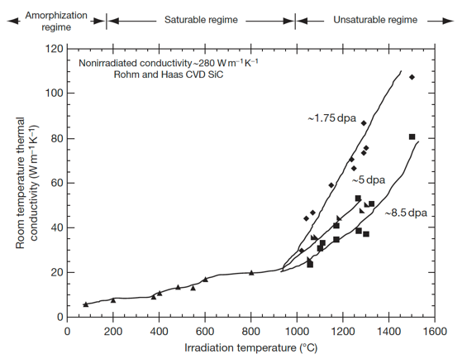
Thermal Conductivity Degradation
In the high temperature void swelling regime, thermal conductivity degradation is not expected to saturate, as voids continue to grow and scatter phonons
Additionally, the linear relationship between swelling and thermal defect resistance does not exist at high temperature
Generally, void swelling does not degrade thermal conductivity as severely as point defects, but data at high T is quite limited

Slide 42
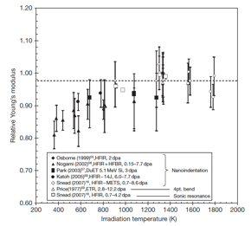
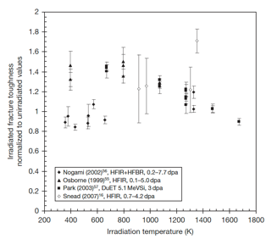
SiC Mechanical Properties
Irradiation generally reduces modulus to a greater extent for lower temperature irradiation, while the modulus reduction becomes negligible when irradiation temperature reaches or exceeds 1273 K
Irradiation-induced toughening (increase in fracture toughness) seems to be significant at 573–1273K in spite of the decrease in elastic modulus
However, there is significant scatter in the data

Slide 43
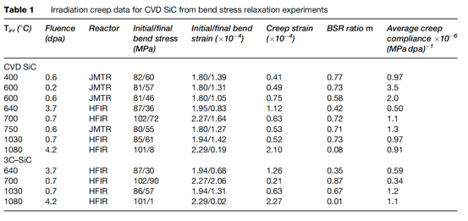
SiC Creep
Irradiation creep is defined as the difference in dimensional changes between a stressed and an unstressed sample irradiated under identical conditions
Studies on irradiation creep of SiC have been limited, although it is of high importance for SiC in TRISO particles
The creep strain for CVD SiC exhibited a weak temperature dependence at <0.7 dpa whereas a major transition at higher doses likely exists at higher temperatures

Slide 44
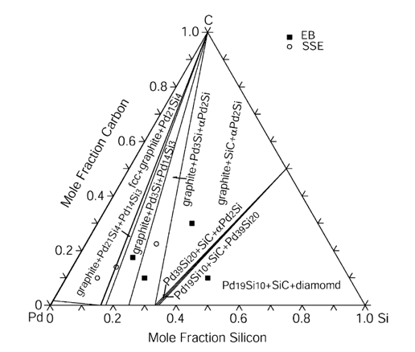
SiC Corrosion
The silicon carbide layer serves as a critical fission product barrier, but can be corroded by fission products, in particular palladium
Additionally, silver can be transported through intact SiC layers
For Pd, the reaction with SiC can be qualitatively explained by the phase-diagram, where a number of intermetallic structures are present
To prevent corrosion by Pd, new combinations of coating layers have been proposed

Slide 45
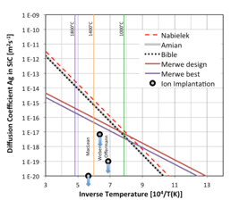
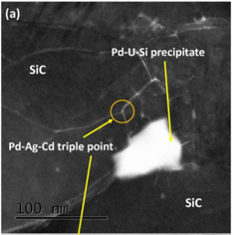
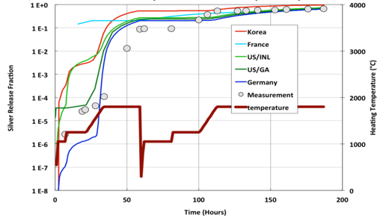
SiC Corrosion
Silver release has been observed from undamaged particles suggesting that Ag migrates through intact SiC layers at temperatures >1100 C
The Ag migration mechanism remains not fully understood, but is still an active area of research
Ag release has a temperature dependence, pointing towards a diffusive mechanism
From microstructural analyses, it seems possible that Ag, Cd and Pd cluster and transport together at grain boundaries and triple points because of their common chemical properties

Slide 46
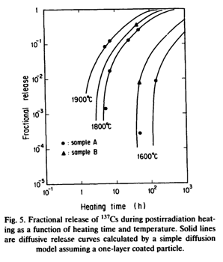
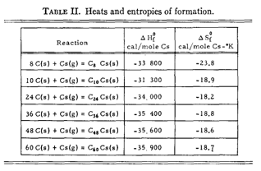
SiC Corrosion
Once cesium has migrated into the buffer, it can react with carbon
At nominal temperatures, cesium may be released and associated with carbon of the buffer layer to form compounds
These compounds, if they are not stable with increasing temperatures, may become a potential source of cesium release
Typically, cesium-graphite compounds are not stable at 923 K under vacuum and decompose to give cesium vapor and graphite

Slide 47
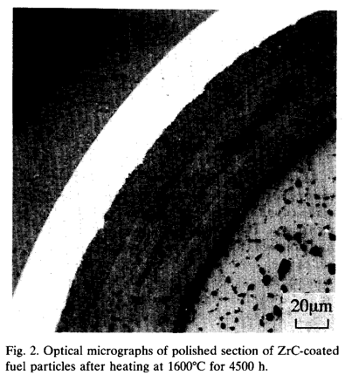
SiC vs ZrC Corrosion
An approach to counteract SiC fission product corrosion is to replace the SiC coating by a ZrC layer
Experimental observations showed neither Pd attack nor thermal degradation of ZrC up to 1600C
ZrC was also shown to have a high capacity to retain Cs, but poor retention of Ru
At higher T, the deterioration of the ZrC particle is caused by failure of the IPyC
The development of TRISO with ZrC-coating is at an early stage compared to the SiC-coated design

Slide 48
Questions?

